Slide 1

Notes:
1st slide (Mandatory)

Slide 2
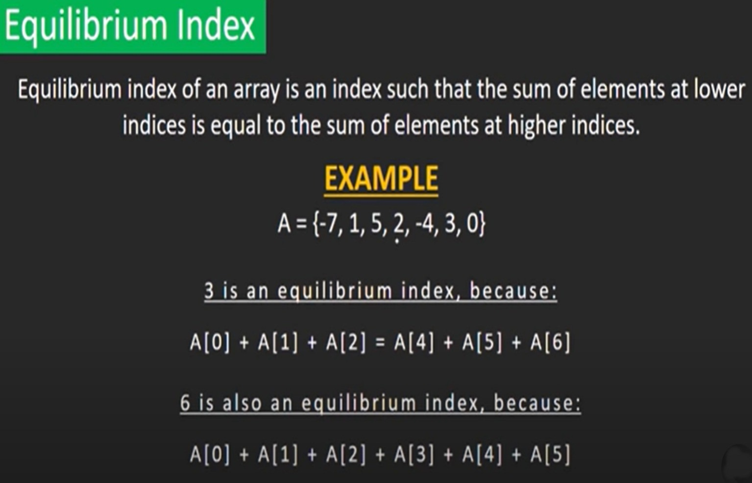


Slide 3
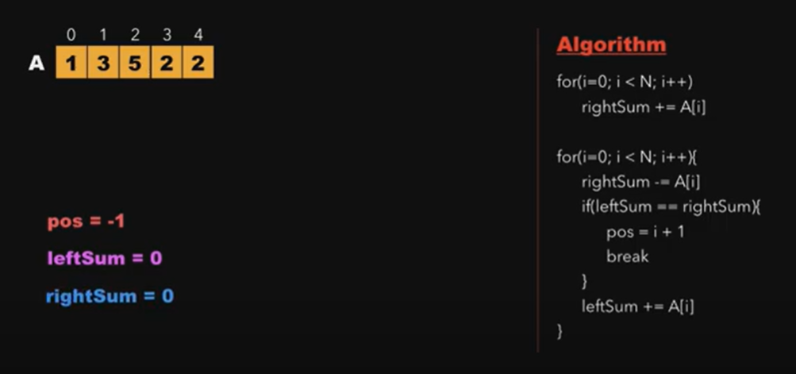

Slide 4
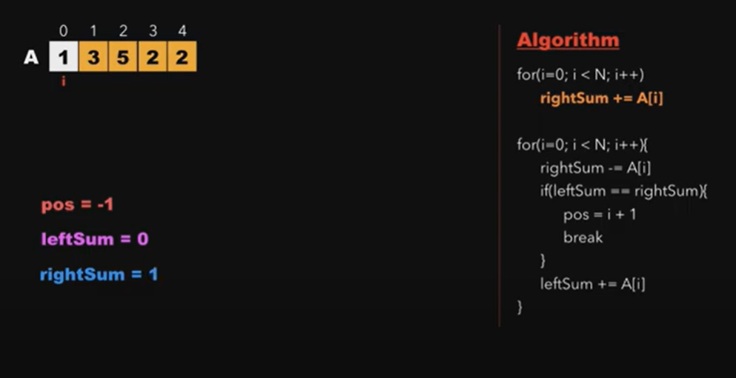

Slide 5
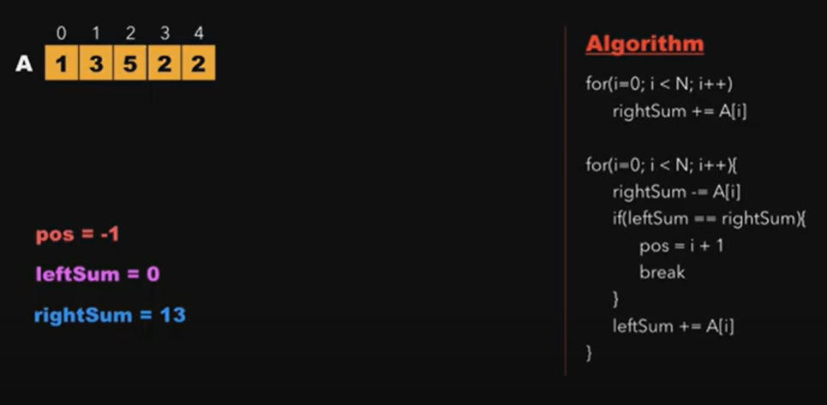

Slide 6
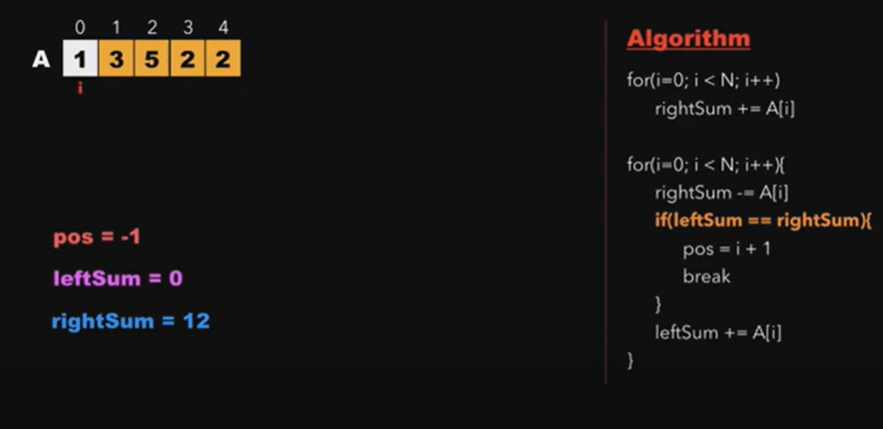

Slide 7
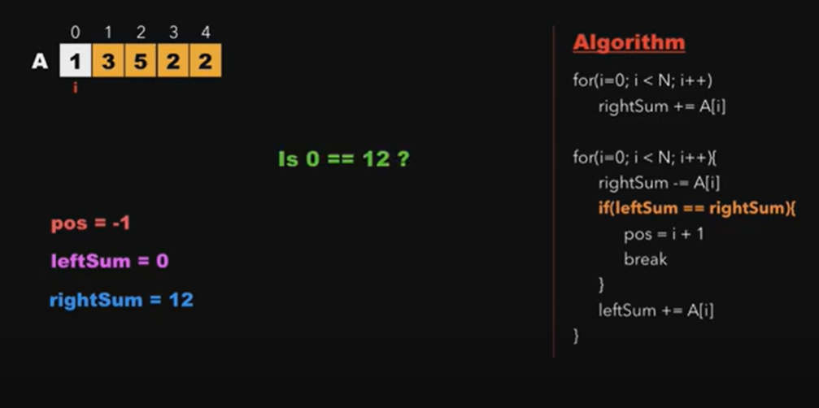

Slide 8
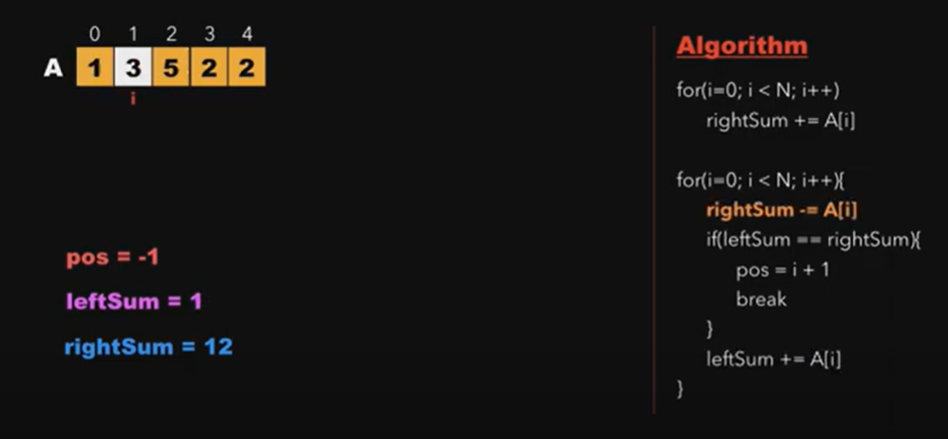

Slide 9
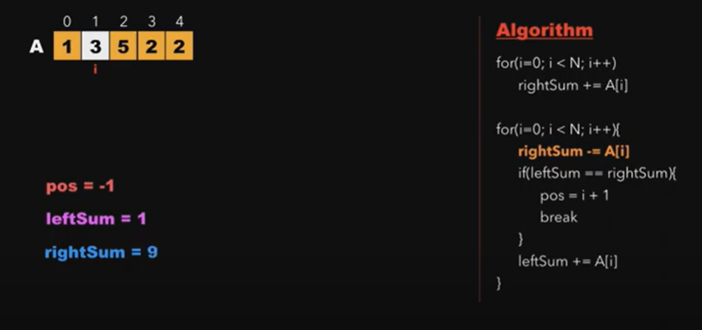

Slide 10


Slide 11


Slide 12
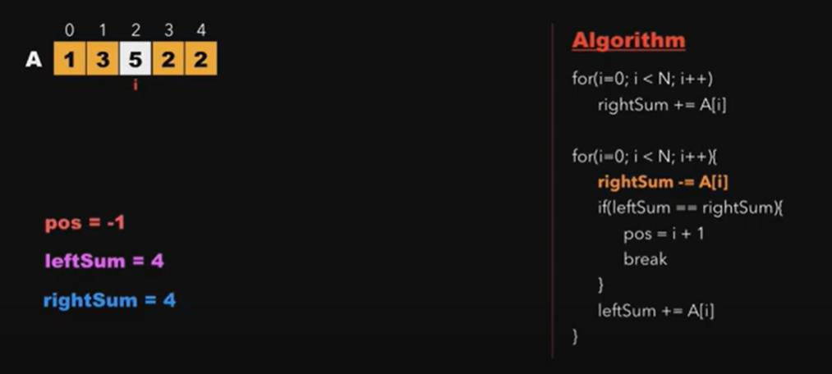

Slide 13
//Max Equilibrium Sum
public class MES {
public static int getMaxEquilibriumSumOptimized(int[] arr) {
int totalSum = 0;
int leftSum = 0;
int maxSum = Integer.MIN_VALUE;
for (int i = 0; i < arr.length; i++) {
totalSum += arr[i];
}
for (int i = 0; i < arr.length; i++) {
totalSum -= arr[i];
if (leftSum == totalSum && leftSum > maxSum) {
maxSum = leftSum;
}
leftSum += arr[i];
}
return maxSum;
}
public static void main(String[] args) {
int[] arr = {1, 2, 3, 4, 5, 4, 3, 2, 1};
int maxSum = getMaxEquilibriumSumOptimized(arr);
System.out.println("Max Equilibrium Sum : " + maxSum);
}
}

Slide 14

THANK YOU

